Slide 1
Project Management for ITM ITM 471/571
Dennis Hood
School of Applied Technology
Fall ‘14

Slide 2

Week 14
Enterprise Project Management

Slide 3
Sim Project Assessment Details
Append 2 pages to your plan document
Page 1 - EVM and supporting metrics
A single EVM graph (original PV line plus EV and AC lines)
1 table of data (duration and cost at each milestone)
1 table of metrics (SV, CV, SPI, and CPI at each milestone)
Page 2 - Analysis
Explain the results of each milestone
Explain improvements you would make next time
Appendix
Include a picture of your masterpiece
Submit by 12/1/14

Slide 4
Lesson Overview
Enterprise Project Management
Reading: Chapter 18
Objectives
Define the concept of enterprise organizations
Explore project management at the enterprise level
Discuss the business climate and how enterprise project management addresses strategy
Examine the process flow of enterprise project management

Slide 5
Enterprise Project Management

Slide 6
The Enterprise
Spanning the organization
Work flows through an organization being processed at “stations” like an assembly line
Business units and administrative functions coordinating efforts to realize strategic goals
“Silos” of commonality (development, sales, HR, manufacturing, etc.)
Organized to manage long-term command and control
Portfolios of projects
Logically related tactical projects defined to address strategic goals

Slide 7
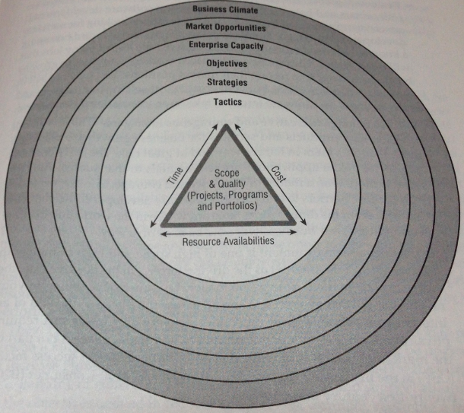
A View from the Top

Slide 8
Enterprise Project Management
Start with the end in mind
Identify the big deliverable
Break it down into phased deliverables
Manage as a collective
All phases must be completed to successfully complete the portfolio
Each phase is a project
Learn as you go, refine plans as necessary
Portfolio perspectives
Progressing toward the strategy’s finish line
A dedicated, finite set of resources

Slide 9
Enterprise PM Process Flow
COLLECT ideas
ANALYZE the ideas to develop a set of tactics
SELECT tactics based on selection criteria
INITIATE by developing plans
EXECUTE the plans and monitor progress
DEPLOY deliverables and support compliance

